Slide 1
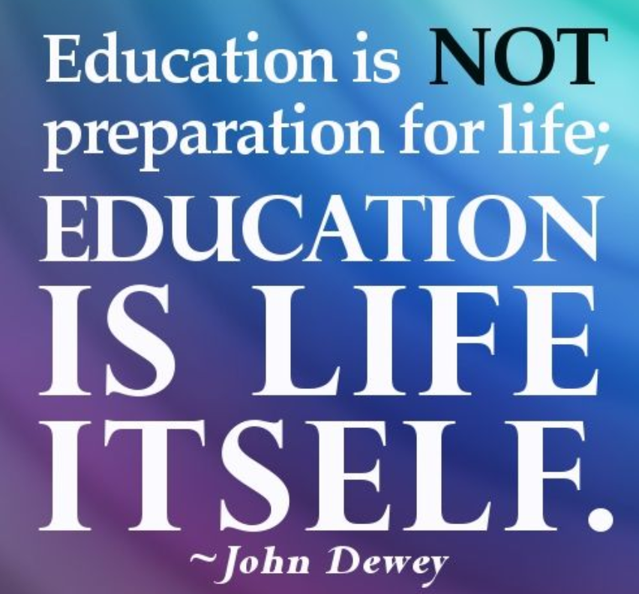

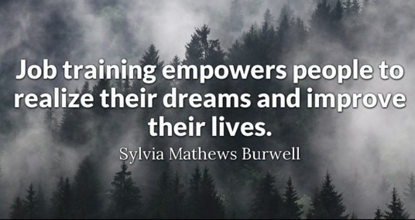

Economic Development & Innovative Workforce Solutions, Central Ohio Technical College Vicki Maple, EdD

Slide 2

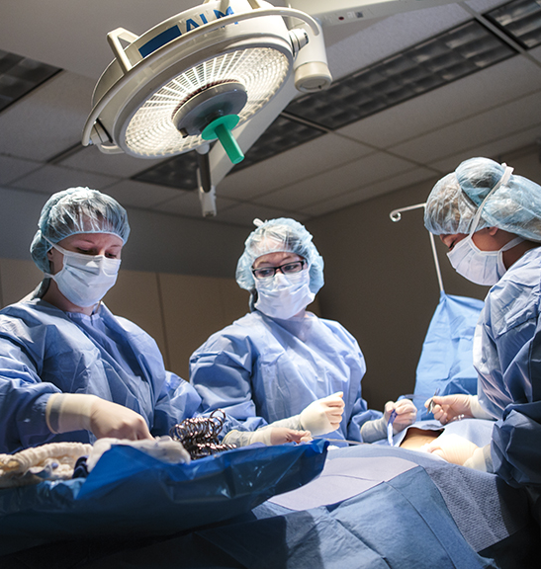
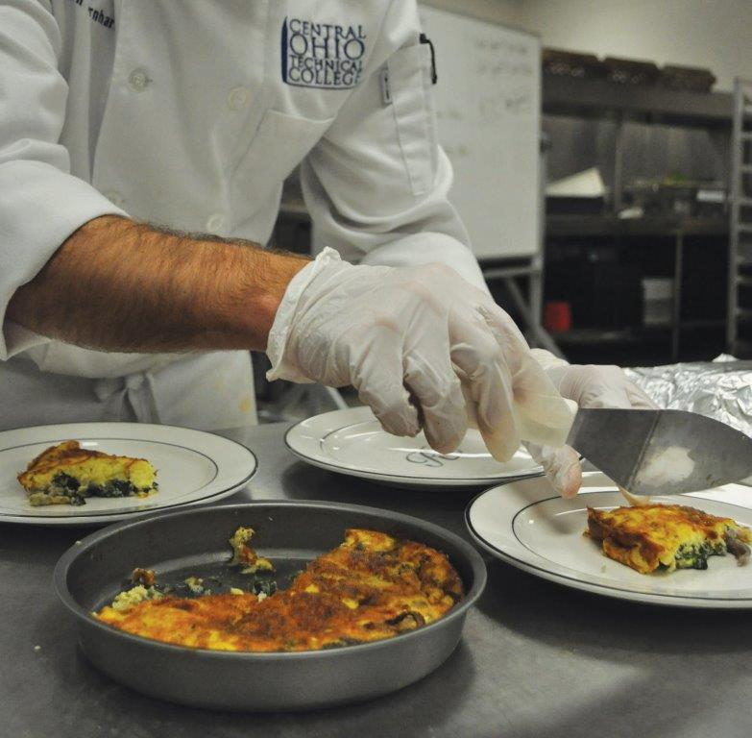


Economic development
co-op, clinical site, and internship opportunities connect students to employers in the community
collaborate with the business community… sit and listen or ask questions without selling… being present and engaged and having the ability to react to employers needs

Slide 3


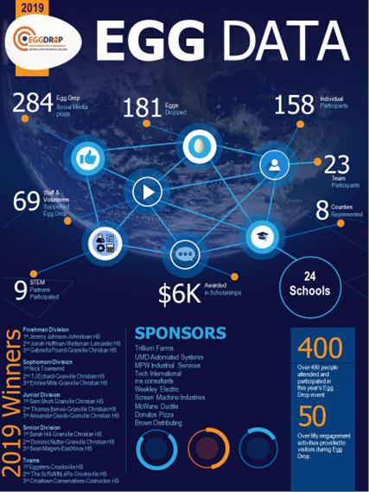
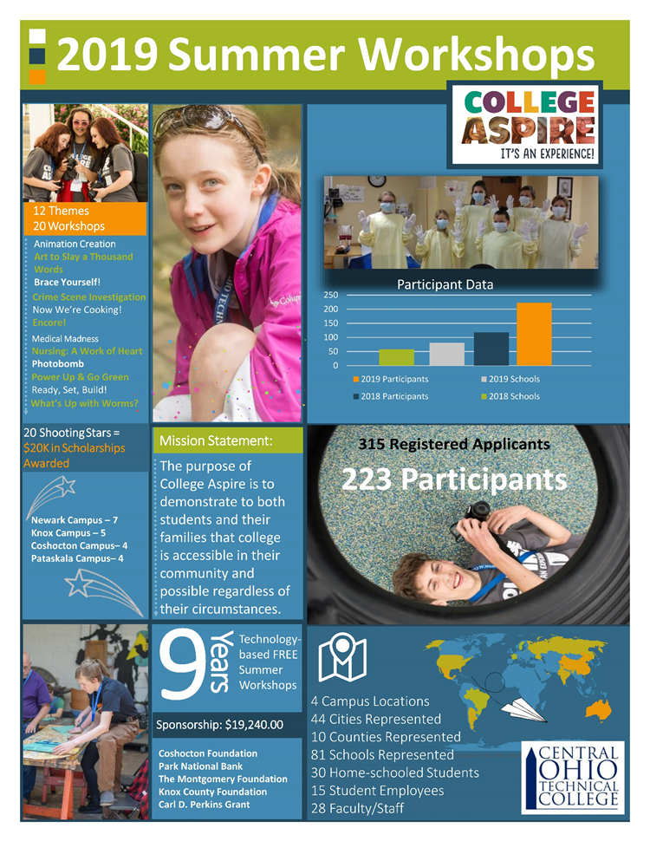

Slide 4
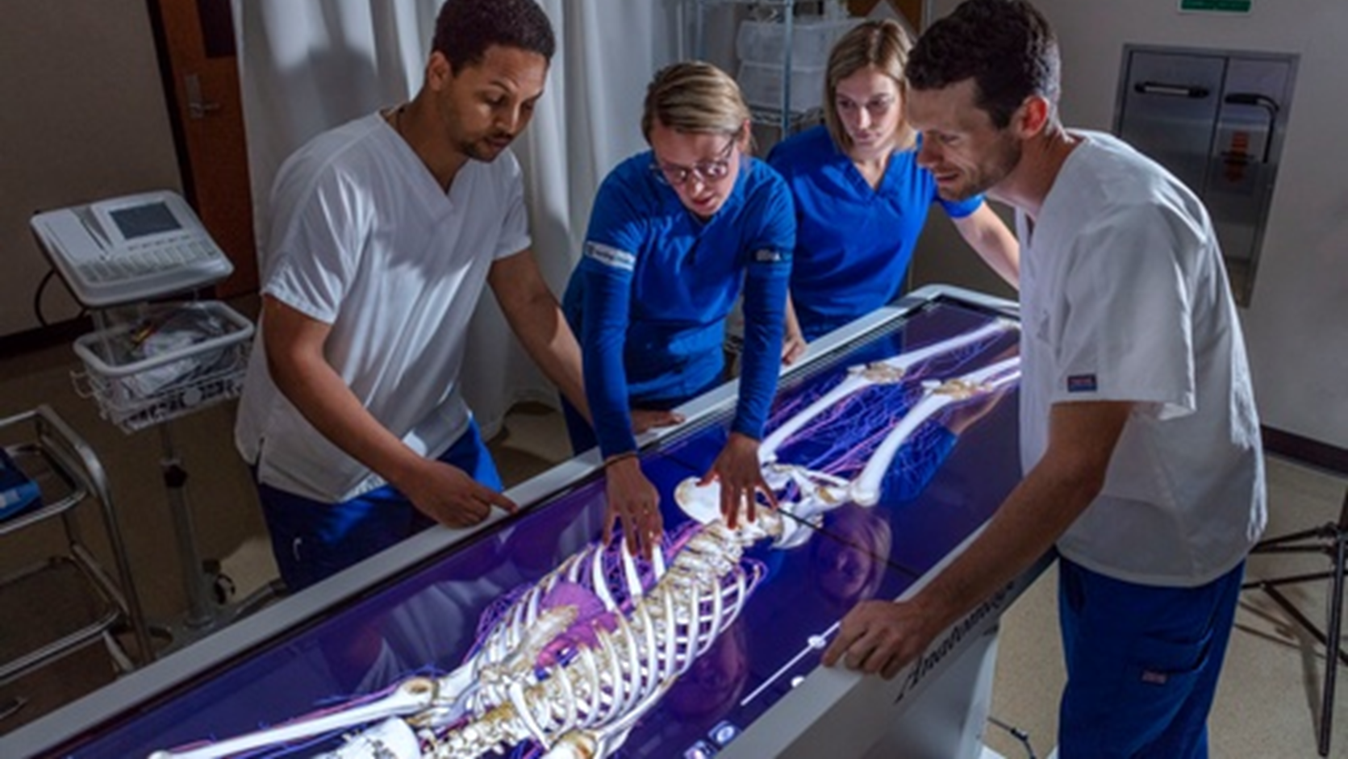
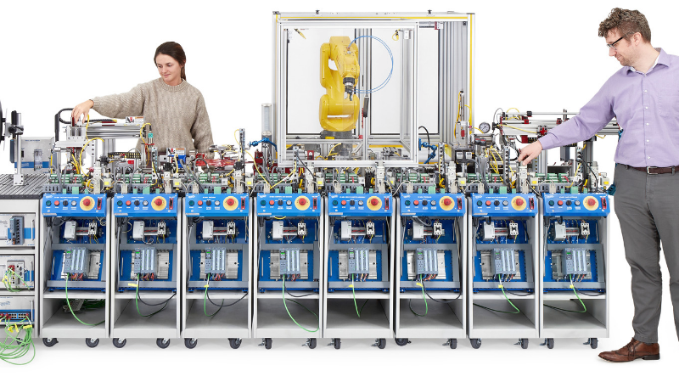
Grant funded efforts to train the future and current workforce

Slide 5

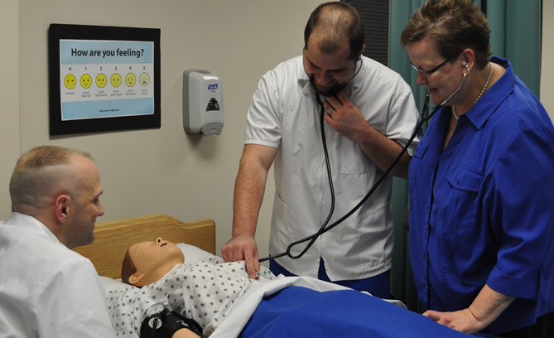





Active workforce / economic development consortia participation.
Linking academic programming and workforce training initiatives to those articulated and requested by area employers.

Slide 6
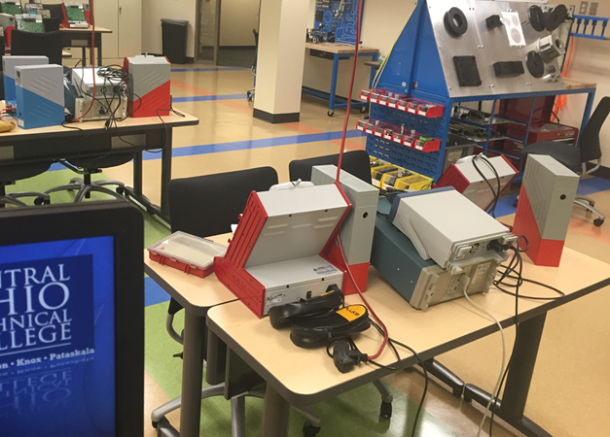
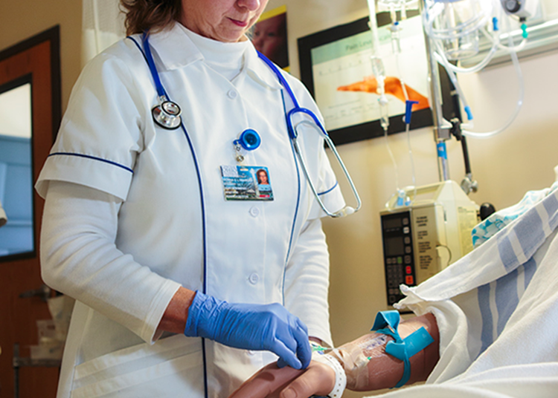
workforce priorities and economic impact assessments
project long-term employment needs for the most critical industry sectors NOW and over the next 10 years

Slide 7

Dr. Vicki Maple
VP for Economic Development & Innovative Workforce Solutions at COTC vmaple@cotc.edu
740-364-9565

Slide 8
